Slide 1

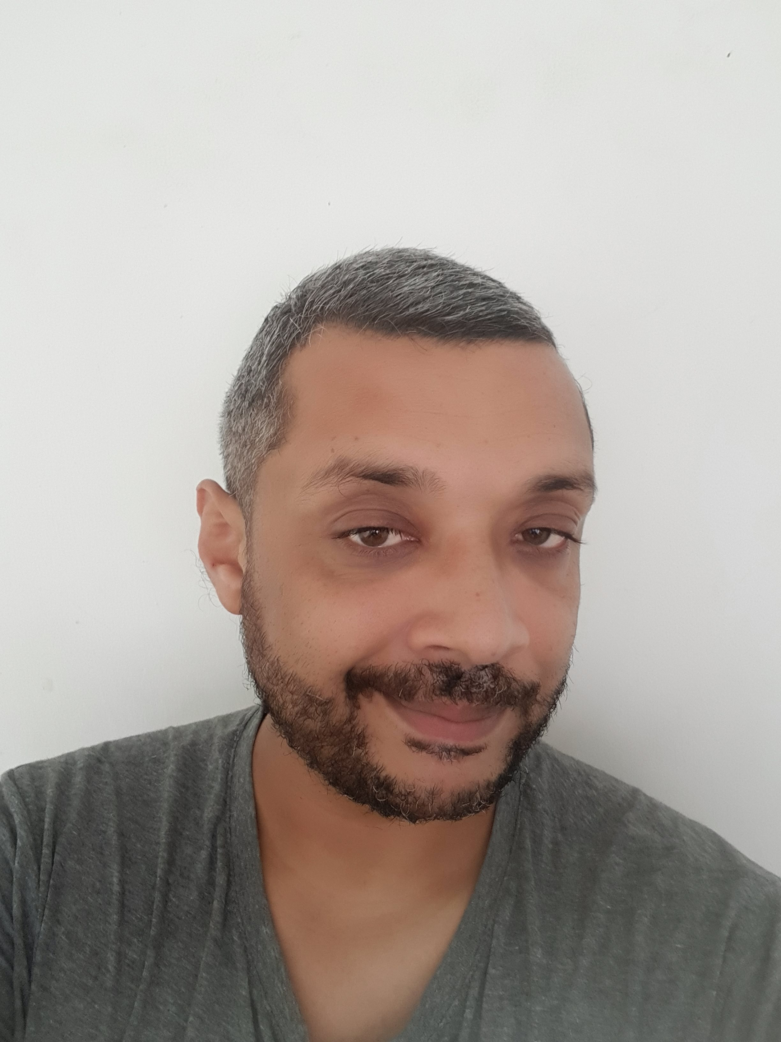

Experience
Areas of expertise
Application Development Specialist/Team Leader
(at Accenture/Avanade Mar 2015 – To Date)
Team Leader Talend
Azure Data Engineer Lead
Lead Support on TTP / TTR and BRQ applications
Manage Harry (Software) on Mainframe(Development and RUN)
Functional
CRM Module
Finance Module (Sales Ledger, Purchase Ledger and Nominal ledger)
Sales and After Sales Modules (i.e.: vehicle Sales, Stock Management…)
Tires Tests
Insurance
Industries
Automotive industry
Banking sector
Pneumatic sector
Industrial Gases
Technical
Azure
Git
BI – ETL and ELT
PLM Enovia
Xnet
IBM AS400 (3270 and Lansa)
SQL
Reporting tools Autoline on DMS (query and ad-hoc)
Jean-Guy Zamudio
Education
Software Engineer
INSTITUT FRANCAIS
Attestation pour une meilleur communication:
Gestion efficace des enjeux et des codes
ITIL Certified
Axelos, 2019
Image professionelle
Centosis, 2009
Certification Lansa pour Windows
TCM Technology, Corporate, Management, 2004
Brevet de Technicien Supérieur en Informatique
et Gestion, option développeur d'applications
Chambre de Commerce et de l’Industrie de Maurice, 2002
Senior Analyst Ebène, Mauritius.
Experience in IBM/AS400 development environment Lansa for 7 Years
Experience in DMS Autoline (ERP) for 5 years
Joined Accenture in April 2015 and currently working as Software Engineer Senior Analyst
I am very versatile in the roles I can take up having had an experience in acting as a developer, support and Trainer.
Professional background

Slide 2

PRODUCTS
Back End Developer
Skills & Technologies
SI project in distributed agile mode
Teams in Mauritius and France
Building Bi Solutions to provide from raw to refined data implemented from migration.
I am responsible for the following project activities:
Leading my Off-Shore development team
Synchronize the different requests of the offshore team responding to both the client's and the team's needs through Agile. For example, by using Poker Planning for providing estimate
Using the tools on Talend Studio and Talend Administrator Centor Git, to: (1) Provide a solution through Talend Integration Data, (2) Manage development, for doing development and peer reviewing and collaborating (3) Creating artifacts, developing and using job scheduling.
Using the tools on Azure including Azure devops, Git, Azure Data Factoy to: (1) Breakdown User Stories into tasks and plan sprints, (2) Manage development, for doing development and peer reviewing and collaborating (3) Creating artifacts, developing and using pipelines.
Regular demos to the business (End of Sprint) for the features implemented.
Currently working with the team to put in place ELT Solutions in Azure to provide Cube, which will be used by the Customer through Power BI
Coach new joiners and help them integrate the team through pair programming and providing support on technical issues.
Skills
Teamwork
Client facing
Analysis & solutions design
Scrum
Technical
Talend Studio
Talend Administrator Center
Azure
Git
BI – ETL and ELT
PLM Enovia
Xnet
IBM AS400 (3270 and Lansa)
SQL
Reporting tools Autoline on DMS (query and ad-hoc)
Notes:
Poker planning (agile) etc android ios xamarin forms – modular app, customisable, theming, retail, push notif
Jmeter

